Slide 1

Predicting the Price of Used Cars
BUAN 6356 - Business Analytics with R
Group 12 - Richard Yang, Yash Salvi, Prachi Sankhala, Han Vo, Yingzhe Geng, Tzu I Lin
Notes:
Hi everyone, we are group 12
Today, we will talk about our analysis on used cars’ price prediction that we found using R. introduce our name…..

Slide 2
Setting
The used car market is a significant sector of the automotive industry, with millions of transactions occurring annually.
Buyers and sellers commonly face challenges in determining fair prices for used cars.
The project aims to develop predictive models using historical sales data to estimate the resale value of used cars (including factors like make, year made, milage).
The objective is to enhance transparency, empower decision-making, and improve transaction efficiency and fairness in the used car market, provide valuable insights to buyers and sellers.
Notes:
As we all may know, buying used cars is very common, especially in the US, and that explains why it takes up a significant sector of the automotive industry. However, buyers and sellers often face challenges in determining fair prices since it fluctuates a lot, especially after covid-19.
Our project aims to develop a predictive models using historical sales to estimate the resale value of used cars. This would enhance transparency, empower decision-making, and importantly improve fairness in the current market, which would assist sellers and buyers with decision-making.

Slide 3
Data
No. | Attribute | Description
1 | brand | The company that manufactured the vehicle.
2 | model | The specific model of each vehicle.
3 | model_year | The manufacturing year of the vehicle.
4 | milage | The number of miles a vehicle has traveled.
5 | fuel_type | The type of fuel the vehicle runs on.
6 | engine | The engine specifications of the vehicle.
7 | transmission | The transmission type of the vehicle.
8 | ext_col | The exterior color of the vehicle.
9 | int_col | The interior color of the vehicle.
10 | accident | The vehicle’s prior history of accidents or damage, if any.
11 | clean_title | Whether or not the vehicle has a clean title.
12 | price | The sold price for each vehicle.
Our project is based on the “Used Car Price Prediction Dataset” from Kaggle, consisting of over 4,000 listings of used car sales in 2023.
Notes:
The dataset we used in this project is the "Used Car Price Prediction Dataset" sourced from Kaggle, consisting of over 4,000 listings of used car sales in 2023. This collection of data was extracted from the popular automotive marketplace website, www.cars.com.
The 12 attributes that are important factors in determine prices, including brand, model, year, and so on, as you can see here.

Slide 4
Challenges
Inconsistent Data Entries
Extreme Values
Analyzing the Distribution of Prices
Including missing values and blank fields. This process involved identifying and formatting these entries, such as converting non-supported fuel types to "Electric" and converting blank entries in the clean title variable to "No", in order to facilitate data consistency
Certain extreme values of the price variables were identified as outliers within the dataset and were removed to prevent skewing the analysis.
Since classification algorithms is used for the analysis, price variable needed to be discretized into categorical categories. This involved calculating the quantiles of the price data to determine the thresholds for each range, ensuring equal representation across the dataset.
Notes:
Despite containing over 4000 rows of observations, the dataset consisted of multiple errors and inconsistencies which compromised its status as a valid and reliable source. These challenges required us to implement a thorough data-cleaning process. One of the more notable issues was the presence of inconsistent data entries, including non-standard representations of missing values and blank fields. This process involved identifying and formatting these entries, such as converting non-supported fuel types to "Electric" and converting blank entries in the clean title variable to "No", in order to facilitate data consistency. Additionally, certain extreme values of the price variables were identified as outliers within the dataset and were removed to prevent skewing the analysis.
Our last major challenge involved analyzing the statistical distribution of the price variable and dividing the data equally into five distinct price ranges. Since we planned on applying various classification algorithms for our analysis, we needed to discretize the price variable into categorical categories. This involved calculating the quantiles of the price data to determine the thresholds for each range, ensuring equal representation across the dataset. Despite the many challenges of the data cleaning and discretization process, we were able to address each issue and ensure the integrity and usability of this dataset for the next steps of our analysis.

Slide 5
Discretize Price into 3 Ranges
High
100%
Prices greater than $41,500
(Count in dataset: 1209)
Medium
66%
Prices greater than $21,000 and less than or equal to $41,500
(Count in dataset: 1176)
Low
33%
Prices less than or equal to $21,000
(Count in dataset: 1188)
We determined the range boundaries by first dividing the price variable set into thirds and classifying each tertile as a “low”, “medium”, and “high” price range.

Slide 6
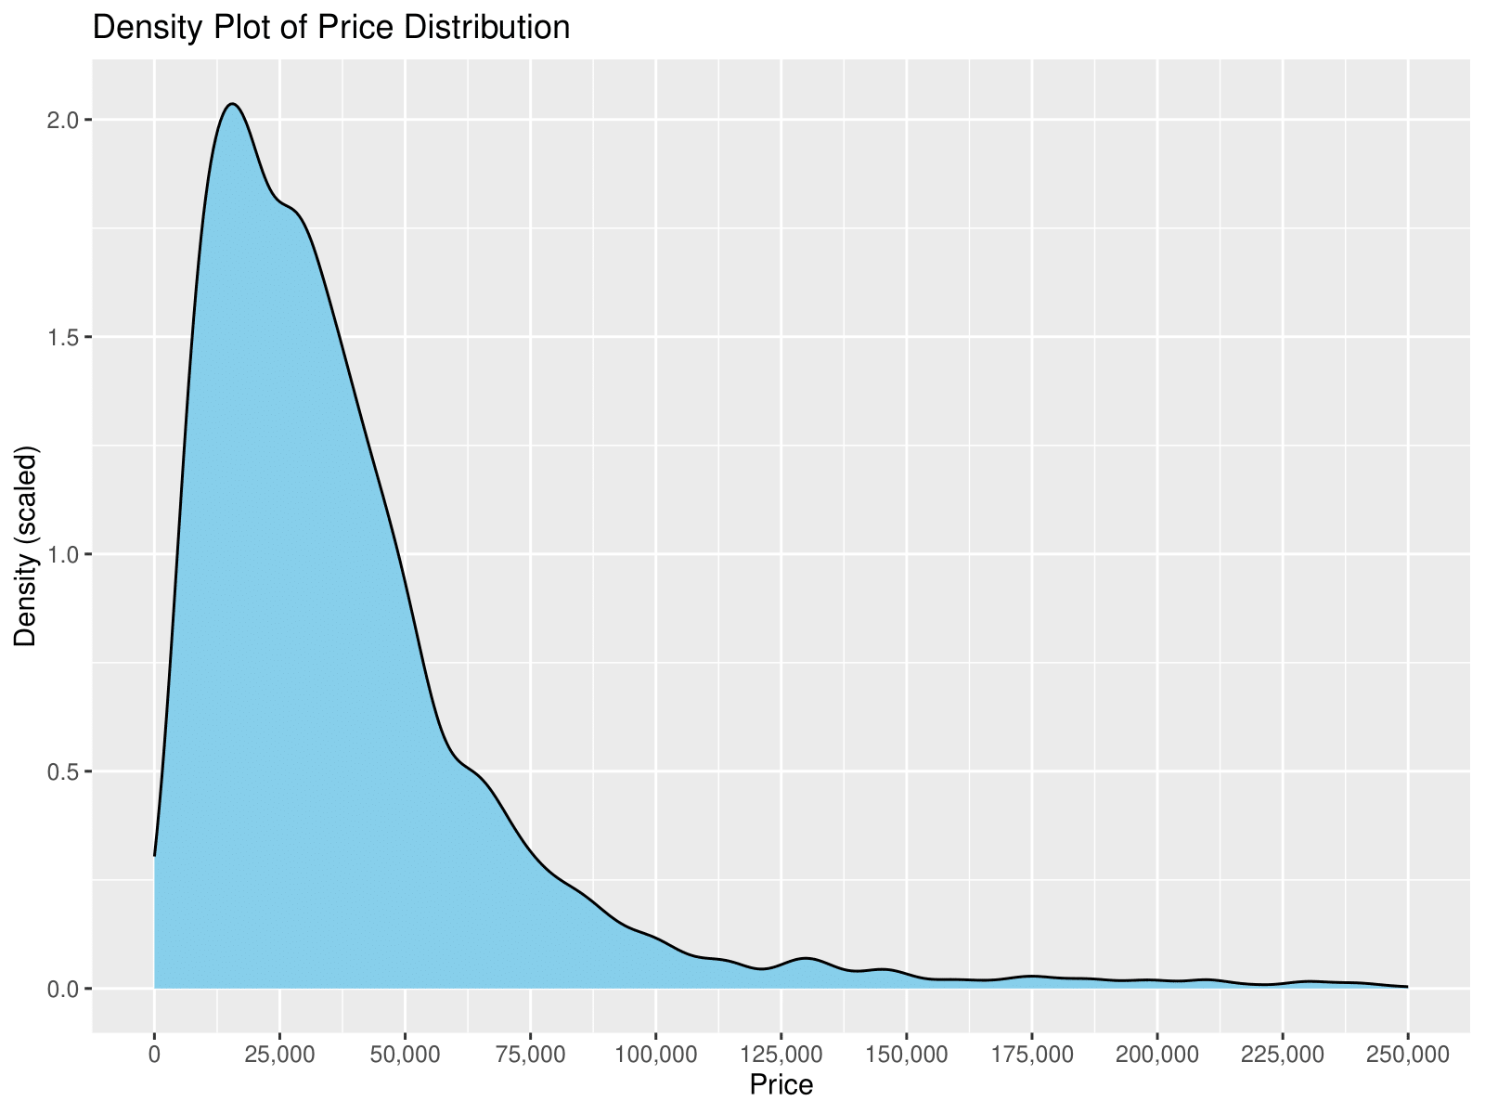
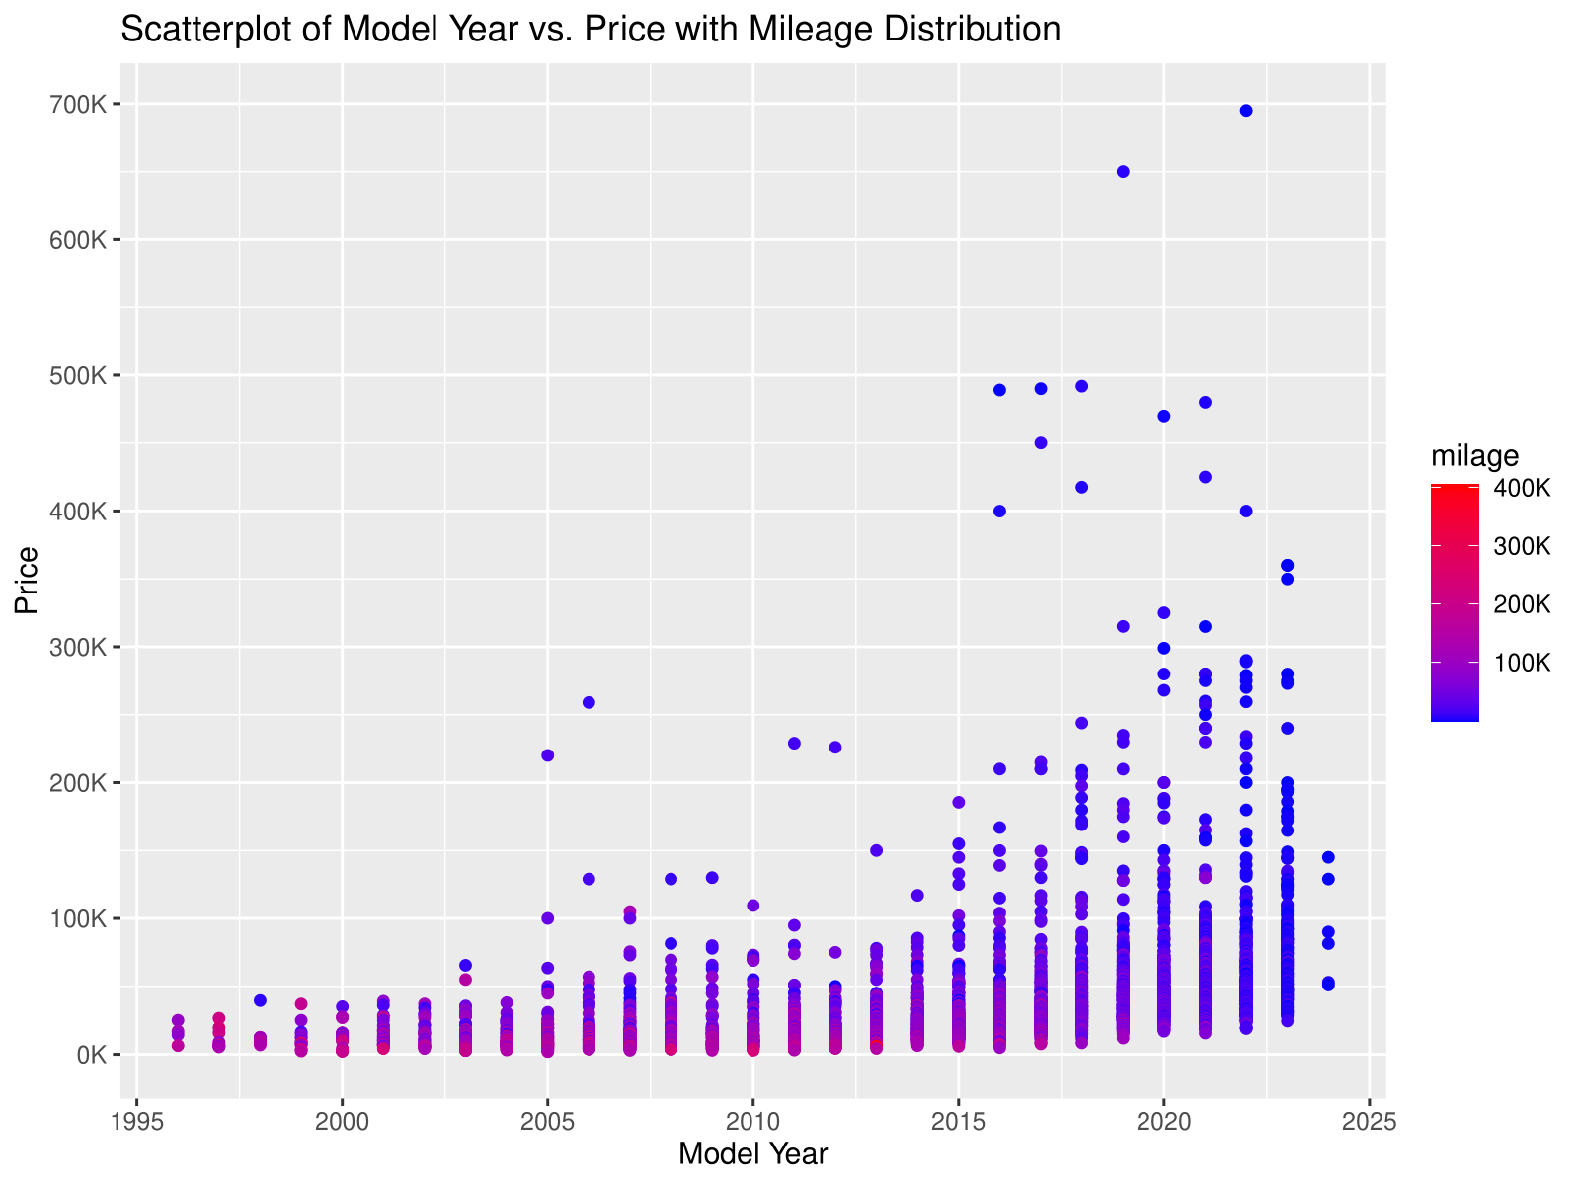
Data Exploration
The price variable of this dataset ranges from $2,000 to $695,000 with a mean of $41,666. The majority of the data, 25% to 75% percentile, lies between $17,000 and $49,000. Only 38 observations contained prices higher than $250,000 (not shown in graph).

Slide 7
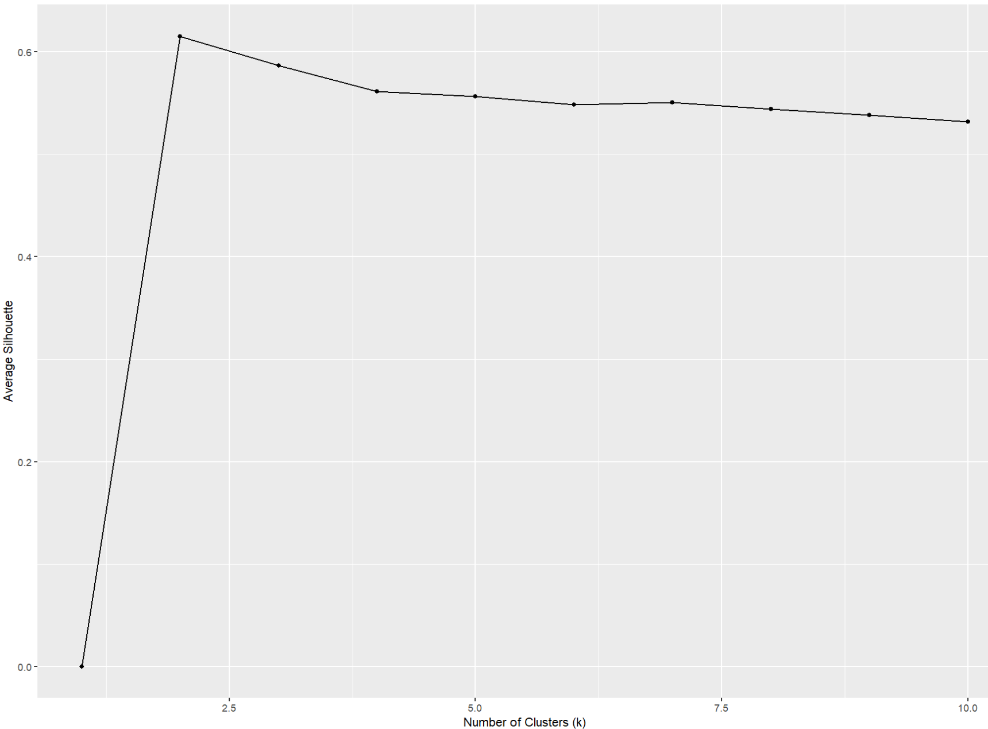
K-Nearest Neighbors
The K-Nearest Neighbors (KNN) algorithm operates on the principle of similarity, where it predicts the label or value of a new data point by considering the labels or values of its K nearest neighbors in the training dataset.
The KNN model involves four steps:
1. Selecting the optimal value of K
2. Calculating distance
3. Finding nearest neighbors
4. Voting for classification
We selected the number of clusters to be 2 based on the average silhouette score.

Slide 8
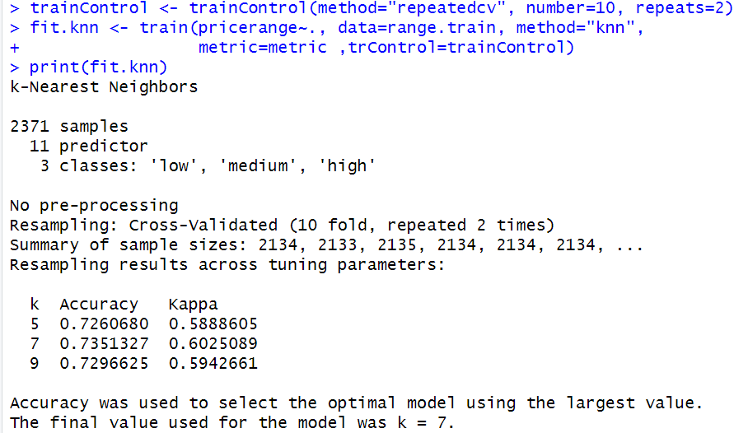
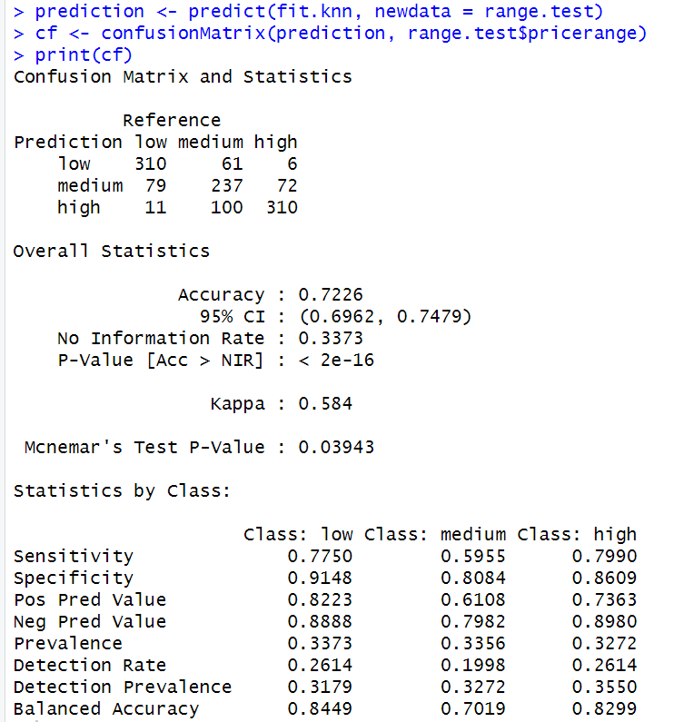
K-Nearest Neighbors
Accuracy score on training data using all variables in the model.
Confusion Matrix (Actual vs. Predicted)
Both models reported an accuracy score of 73.5% on the training data and an accuracy score of 72.26% on the test data.

Slide 9
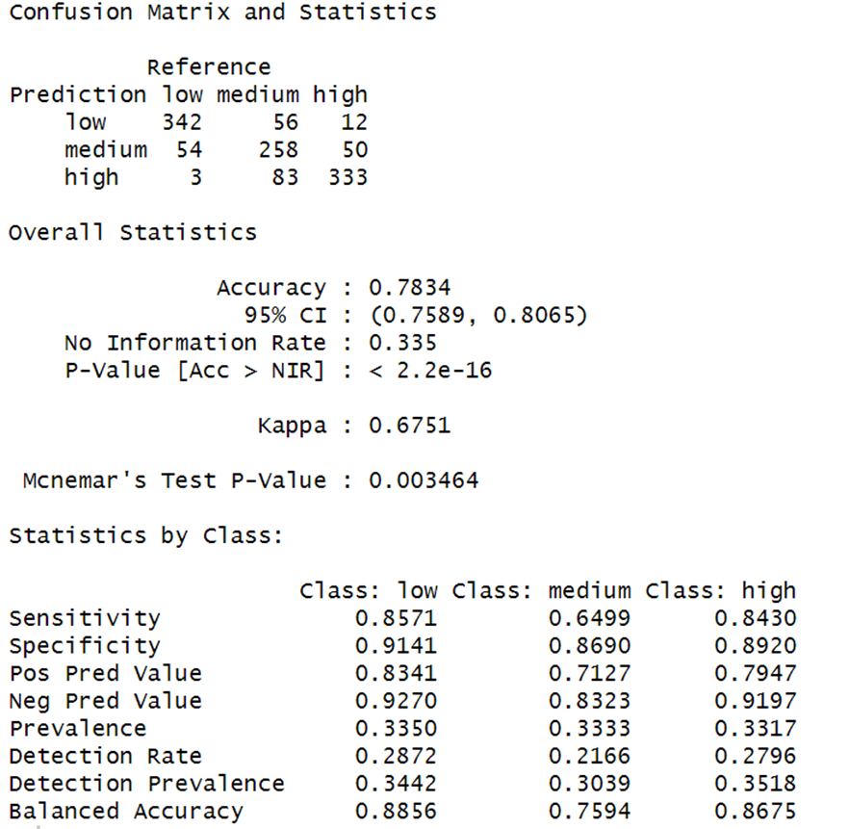
Naive Bayes
Naive Bayes is a classification technique based on Bayes' theorem with an assumption of independence between predictors.
The confusion matrix indicates that the model has a higher probability of correctly predicting both the "Low" and "High" price ranges compared to the "Medium" price range.
Confusion Matrix (Actual vs. Predicted)

Slide 10
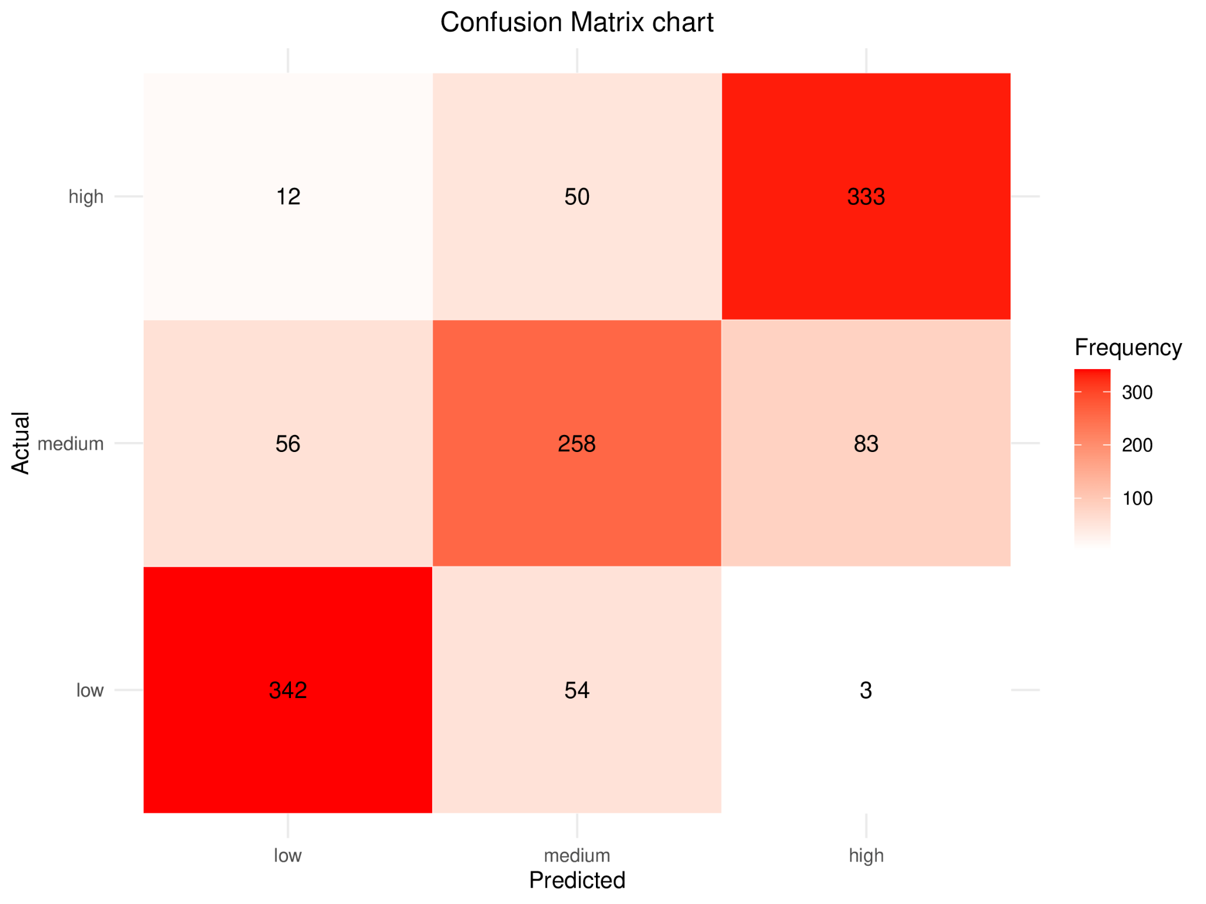
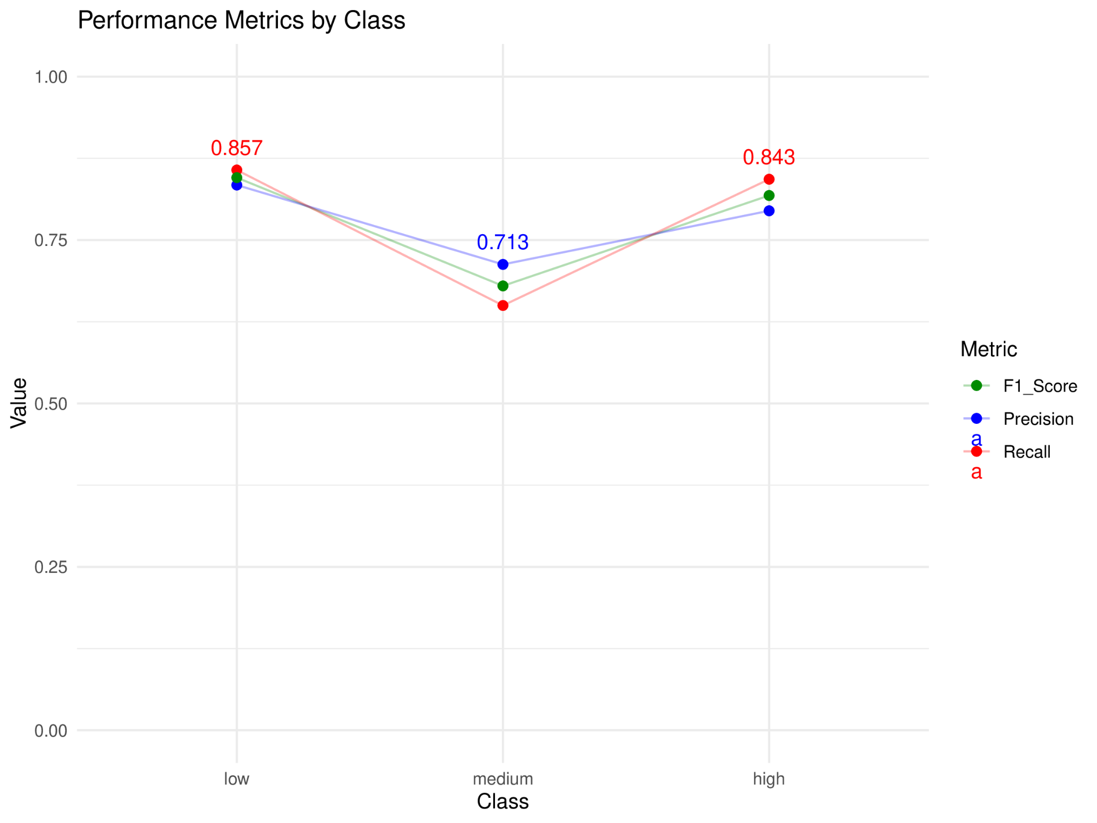
Naive Bayes
Based on the data analysis, the classifier achieved an overall accuracy of 78.34%, meaning that almost 78% of instances were correctly classified across all classes.

Slide 11
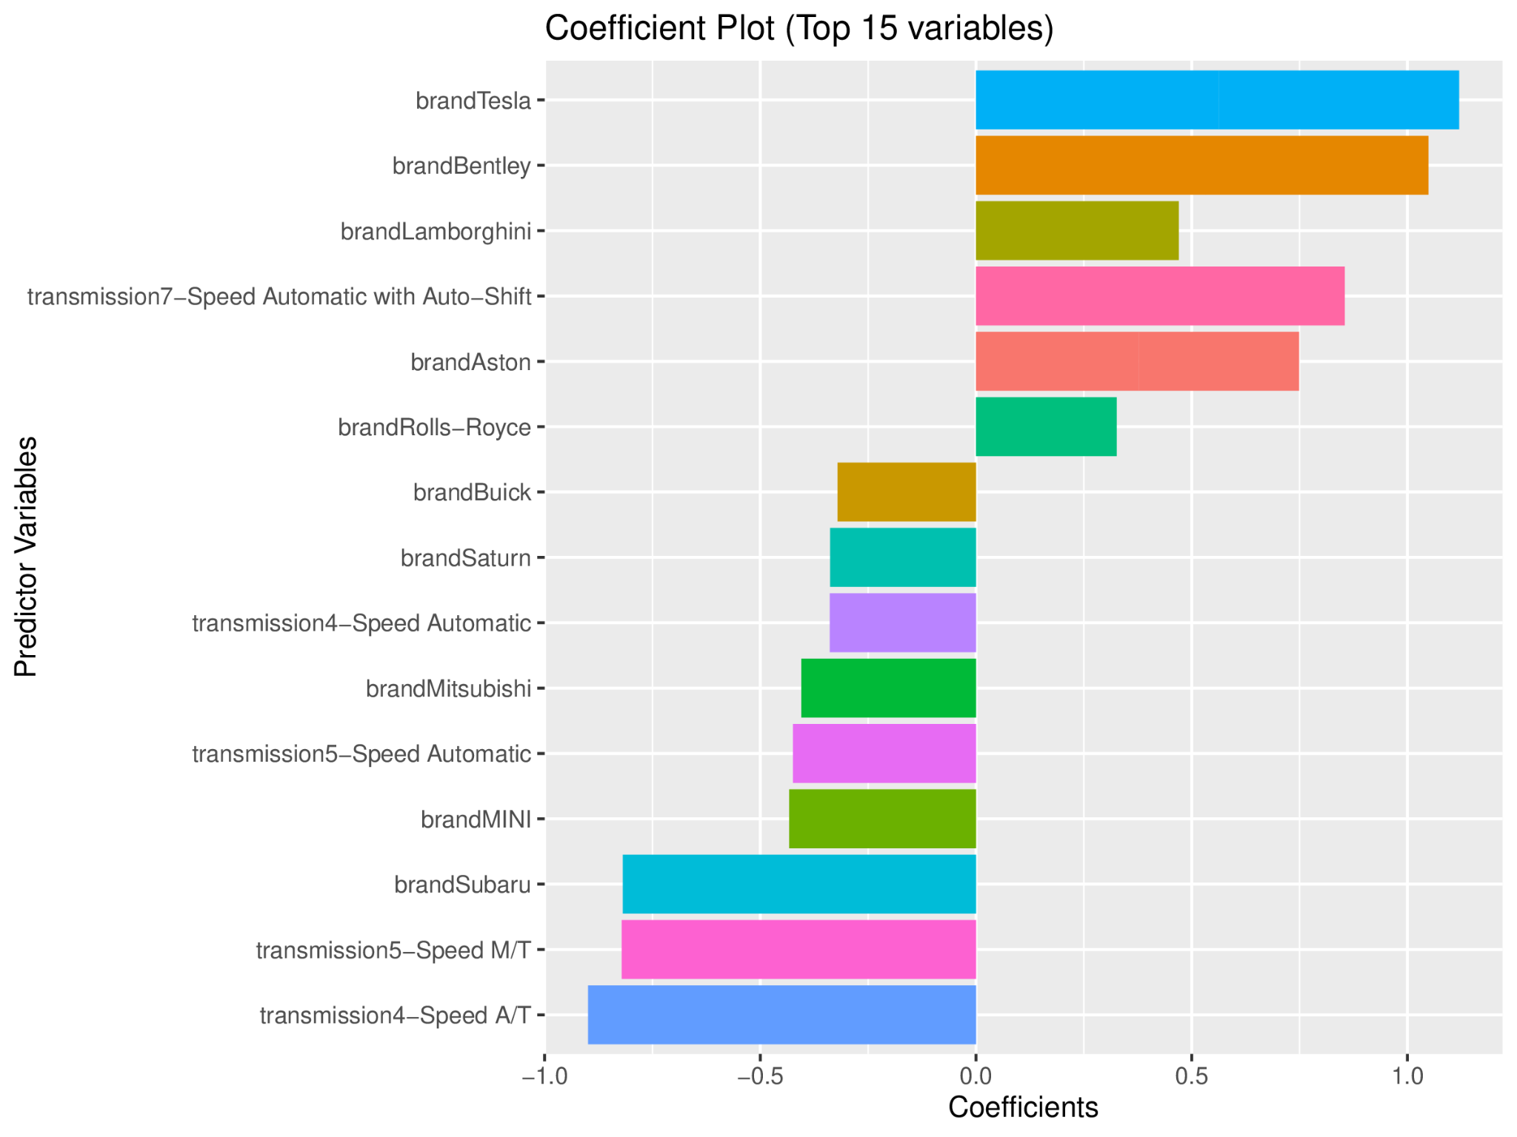
Logistic Regression
Multinomial Logistic Regression, an extension of binary logistic regression, allows for the prediction of outcomes with more than two categories.
Our multinomial logistic regression model received an accuracy score of 74.56%.
The plot examines the magnitude and direction of each coefficient estimate. Positive coefficients indicate a positive relationship between the predictor variable and the outcome variable, while negative coefficients indicate a negative relationship.
Notes:
A limitation of the multinomial logistic regression for our dataset was that it contained a large set of features which exceeded the number of weights the neural network is able to learn during the training process. As a result,

Slide 12
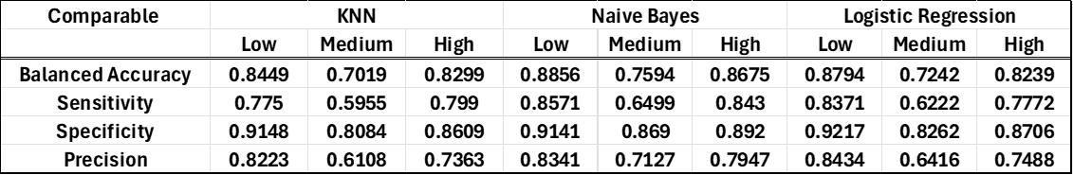
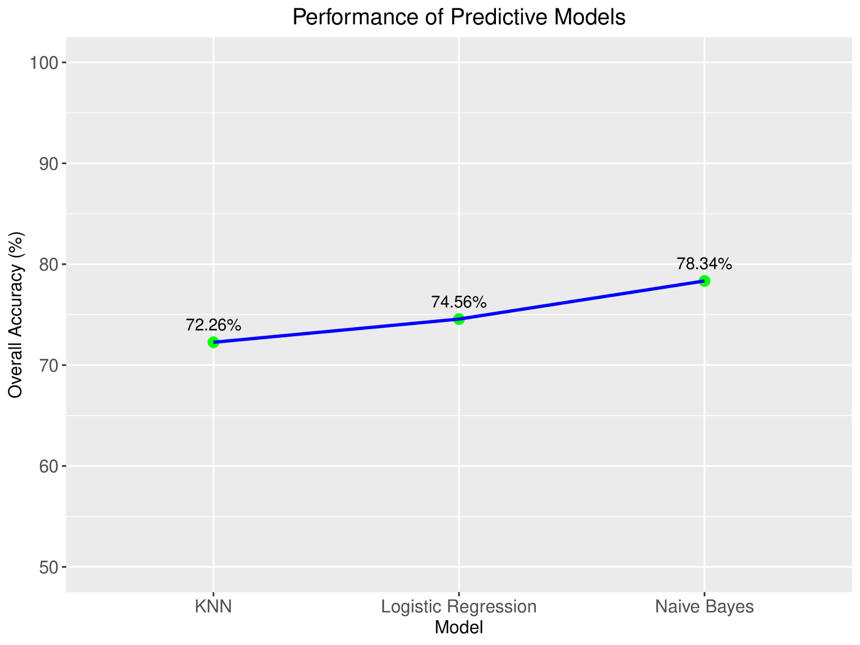
Analysis Summary
Naive Bayes, scoring consistently well across multiple metrics, proved to be the best-performing model in terms of overall accuracy.
KNN and Logistic Regression performed best for Low Price category.
Naive Bayes performed best for Low and High Price categories.
The Medium price category appeared to be more challenging for all models in terms of sensitivity.
Notes:
KNN Model: It predicts labels by considering the majority class of the nearest neighbors. K=2 was found to be the optimal number of clusters, achieving an accuracy score of around 72.26%. While effective for low and high price ranges (over 80% accuracy), its accuracy dropped for medium price ranges.
Naive Bayes: This model predicts class probabilities assuming feature independence. Despite its simplistic assumptions, it achieved an overall accuracy of 78.34%. Sensitivity and precision peaked for low and high price ranges but dropped for medium ranges. Specificity remained consistently high.
Multinomial Logistic Regression: Adapted for multi-class classification, this model identified key predictors impacting price classification. It achieved a similar high accuracy score of 74.56% compared to other models. Positive coefficients for certain predictors indicated their influence on specific price categories.

Slide 13
Project Summary
Our project aimed to predict used car prices using different type of prediction models, offering a clearer view of the market for buyers and sellers. Our group work with a Kaggle dataset, overcoming challenges like missing values and outliers through careful data cleaning, also encountered some new findings about accuracy.
In our project we used K-Nearest Neighbors, Naive Bayes, and Logistic Regression models, analyzing them against metrics to get accuracy and precision. Naive Bayes performed the best, suggesting that probabilistic models could effectively assess used car values in a more transparent and fair predictions.

Slide 14



Thank you for listening
Source
https://www.kaggle.com/datasets/taeefnajib/used-car-price-prediction-dataset

